Slide 1


Final Year Project
Network Vigilance: AI-Powered Multi-Layered APT Protection
Supervised By: Mr. Syed Yawar Abbas (Lecturer)
Co-Supervised By: Dr. Jawaid Iqbal (Assistant Professor)

Slide 2
Project Team
Anas Mustafa Hashmi (37520)
Kabeer Ahmed (27970)
Yasir Mahmood (36546)

Slide 3
Table of Content
Background and Introduction
Market Survey
Problem Statement
Project Scope
Proposed Solution
Requirements Summary
Design Summary
Methodology
Implementation Summary
Experiments and Results Summary
Testing Summary
Conclusion and Outlook

Slide 4
BACKGROUND AND INTRODUCTION

Slide 5
Background and Introduction
Background:
APTs (Advanced Persistent Threats) are stealthy, long-duration cyberattacks targeting critical data.
Traditional tools (firewalls, antivirus) fail to detect evolving, sophisticated attacks.
Rise in AI-driven cybersecurity to combat real-time threats.

Slide 6
Background and Introduction
Introduction:
Our project integrates supervised (Random Forest) and unsupervised (Isolation Forest) ML models.
Designed for real-time detection, low false alarms, and automated threat response.
Offers dual-model consensus detection, IP blocking, and session logging.

Slide 7
Market Survey

Slide 8
Market Survey
APTs are stealthy, long-lasting attacks that evade traditional security systems.
Most legacy systems (firewalls, signature-based IDS) fail to detect them in real-time.
Modern solutions use AI, behavior analysis, and automation.
This survey evaluates tools like Snort, Suricata, Zeek, FireEye, CrowdStrike, and Darktrace.

Slide 9
Market Survey
APT Detection Tools: Strengths & Weaknesses
Snort: Lightweight, rule-based, but fails against zero-day attacks.
Suricata: High-performance, but high false positive rates.
Zeek (Bro): Deep traffic analysis, lacks built-in blocking.
FireEye / CrowdStrike: Effective but costly and closed-source.
Darktrace: Uses self-learning AI, but is a black-box and expensive.
Network Vigilance: Combines open-source flexibility with dual-model AI and real-time IP mitigation.

Slide 10
Market Survey
Comparative Analysis of Tools and Ours
Feature | Snort/Suricata | FireEye/CrowdStrike | Deep Learning IDS | Network Vigilance
Signature-based Detection | ✅ | ✅ (Partially) | ❌ | ✅
Behavior-based Detection | ⚠️ Limited | ✅ | ✅ | ✅
Real-time Blocking | ⚠️ Limited | ✅ | ❌ | ✅
Model Type | ❌ | Proprietary | CNN, RNN | Random Forest + Isolation Forest
Open Source | ✅ | ❌ | Varies | ✅
IP Control | ❌ | Limited | ❌ | ✅

Slide 11
Market Survey
Extended Feature Comparison Table
Feature | Snort/Suricata | FireEye/CrowdStrike | Deep Learning IDS | Network Vigilance
Detection Type | Signature | Signature + Behavior | ML-based | AI Consensus (RF + IF)
Supervised ML | ❌ | Partial | ✅ | ✅
Unsupervised ML | ❌ | Rare | ✅ | ✅
Admin Interface | ❌ | ✅ | ❌ | ✅
Logging | Basic | ✅ | ❌ | PostgreSQL-based
Custom Dataset | ❌ | ❌ | Public | Custom Lab Dataset
Cost | Free | $$$ | Varies | Free (for Dev/Research)

Slide 12
Market Survey
Open-source tools lack automation and anomaly detection.
Commercial tools are powerful but unaffordable and inflexible.
Academic models focus on accuracy but miss real-time deployment needs.
Network Vigilance bridges this gap by:
Combining supervised + unsupervised AI
Enabling real-time IP blocking
Providing secure admin control and full session logging

Slide 13
Literature Review

Slide 14
Literature Review
Snort, Suricata, Zeek: Rule-based, open-source IDS – struggle with zero-day threats.
FireEye, CrowdStrike: Commercial, strong behavior detection – expensive and proprietary.
AI-based IDS (CNN, LSTM): Promising in research but lack real-time blocking and deployment feasibility.
Our system bridges this gap by combining open-source AI detection with real-time automation.
Open-source flexibility
Dual-model consensus
Real-time detection + IP control
Session-wise logging in PostgreSQL

Slide 15
PROBLEM STATEMENT

Slide 16
Problem Statement
Existing tools often rely on signatures or single-model ML, increasing false alarms or missed threats.
Many systems lack real-time blocking, admin control, or detailed session-level tracking.
Need for an intelligent, adaptive system for live threat detection and mitigation.

Slide 17
ENDEAVOUR

Slide 18
Endeavour
Team Roles:
Anas: Backend development, ML model integration
Kabeer: Frontend dashboard, session management
Yasir: Traffic capture, virtual lab simulation & testing
Development Process:
Agile with weekly milestones.
Collaboration via GitHub (branching, commits, merge requests).
Way of Working:
Daily stand-ups, weekly review with supervisor.
Role rotation for knowledge sharing.

Slide 19
PROPOSED SOLUTION

Slide 20
Proposed Solution
Real-time APT detection system using Random Forest + Isolation Forest.
Dual-model decision logic reduces false positives.
Admin dashboard supports IP blocking/unblocking, PDF reports, and flow monitoring.
PostgreSQL for session logging, traceability, and auditability.

Slide 21
Requirements Summary
Functional Requirements:
Real-time traffic capture (dumpcap)
Feature extraction (Python)
Dual-model threat detection
Session-based PDF generation
Secure IP block/unblock interface

Slide 22
Functional Requirements
Requirement ID | Description
FR1 | Capture network traffic in real-time using dumpcap.
FR2 | Custom python script used for feature extraction.
FR3 | Detect network threats using Random Forest and Isolation Forest models.
FR4 | Generate session-based PDF threat reports.
FR5 | Store session data, detections, and IP logs in PostgreSQL.
FR6 | Allow manual unblocking of IPs via the user interface.
FR7 | Automatically block IPs with a defined threshold

Slide 23
Requirements Summary
Non-Functional Requirements:
Detection within < 1.2 sec
Accuracy > 94%
Admin dashboard (Secure login)
PostgreSQL logging and PDF reports

Slide 24
Non-Functional Requirements
Category | Description
Performance | Detection and blocking must be completed within seconds after flow analysis.
Scalability | Capable of scaling through additional sensors and modular deployments.
Maintainability | Modular design for easy upgrades and troubleshooting.
Accuracy | Aims for high true positive rates and low false positives.
Usability | User-friendly interface for viewing logs, reports, and managing IPs.
Security | Secure PostgreSQL access and enforced admin authentication for all operations.

Slide 25
Design Summary
Modular architecture:
Packet capture
Feature extraction
Dual-model analysis
IP mitigation logic
Secure admin dashboard

Slide 26
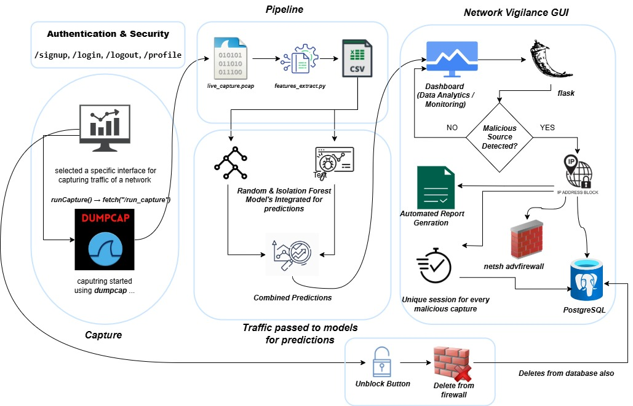
System Architecture Diagram

Slide 27
Methodology
Simulate attacks in VMware lab (5 types)
Capture traffic using Dumpcap
Convert to flows using CICFlowMeter
Extract 84 features per flow
Train models (Random Forest, Isolation Forest)
Real-time analysis & IP blocking
Store data in PostgreSQL
Admin can monitor & unblock via dashboard

Slide 28
Implementation Summary
Developed with Python (Flask backend)
PostgreSQL stores logs, IPs, sessions
Frontend: HTML, CSS, Bootstrap
Real-time predictions every 30 seconds
Blocking Logic: via netsh firewall rules
Secure login using PBKDF2 hashed passwords

Slide 29
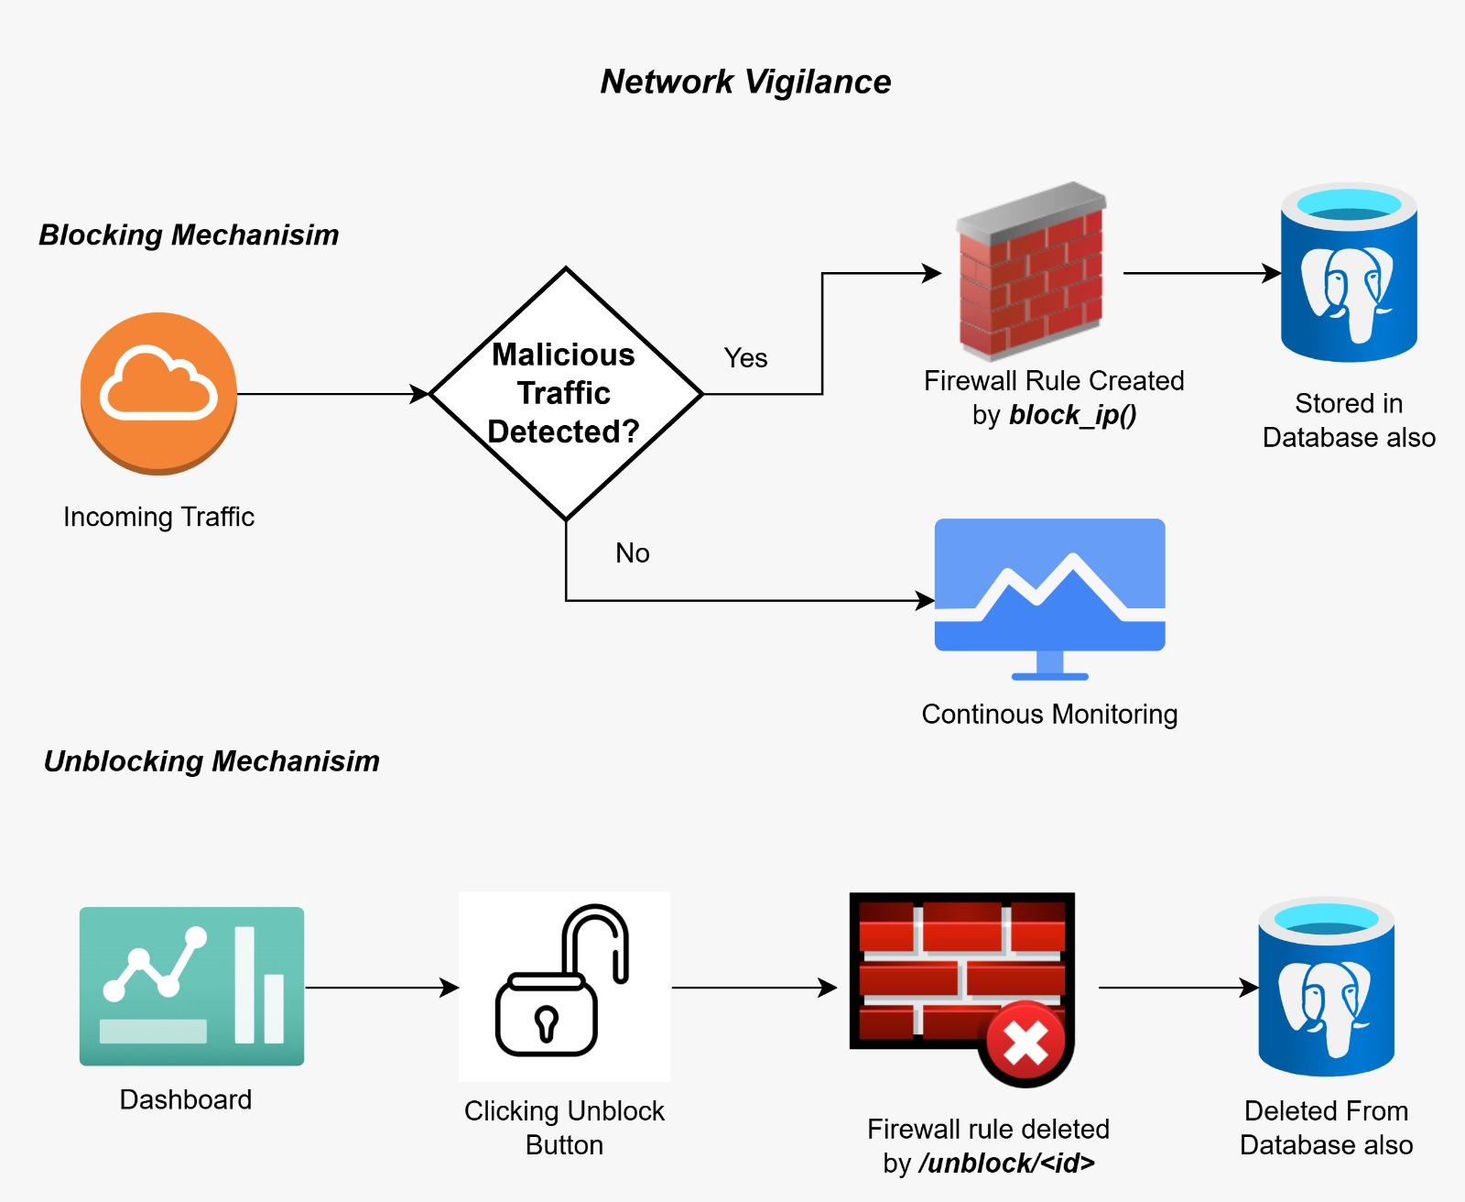
Blocking/Unblocking Logic

Slide 30
Experiments and Results Summary
Model Accuracy (Random Forest):
Accuracy: 94.54%
Precision: 93.93%, Recall: 95.24%, F1: 94.58%
ROC-AUC: 0.99
Isolation Forest:
Conservative anomaly detection
AUC: 0.96, Low false positives

Slide 31
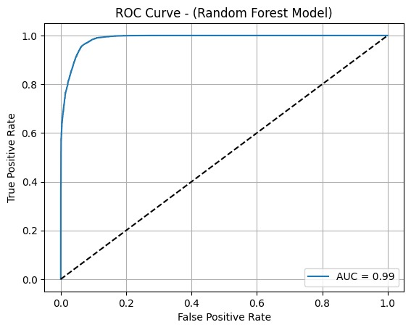
(ROC Curve)

Slide 32
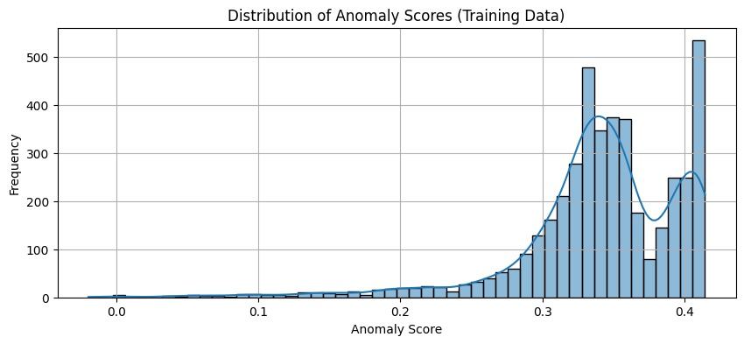
(Anomaly Score Distribution)

Slide 33
Testing Summary
Security Testing:
Confidentiality: Passwords hashed (PBKDF2)
Integrity: PostgreSQL transaction-safe logs
Availability: Continuous pipeline monitoring
Authenticity & Accountability: Admin-only access, all actions logged

Slide 34
Security Verification
Property | Description
Confidentiality | Admin login credentials are hashed using PBKDF2 with SHA-256 for secure storage.
Integrity | Detection results and logs are stored securely in PostgreSQL with transaction safety.
Availability | The detection pipeline and database are monitored for responsiveness and uptime.
Authenticity | Only authorized admin access is allowed through a secure login portal.
Accountability | Each detection action is logged with a timestamp and source IP in the database.

Slide 35
CONCLUSION AND OUTLOOK

Slide 36
Conclusion & Outlook
Achievements:
Real-time APT detection with dual AI models
Automated firewall mitigation
Detection time < 1.2 seconds
Admin portal with logging, reports, and audit trail
Future Work:
Cloud deployment & distributed sensors
Model optimization for multi-class attack classification
Integration with external threat intel feeds
More adversarial testing

